Slide 1
Introduction to Pandas & Jupyter
Lesson 4.1
Notes:
1.1

Slide 2
Class Objectives
By the end of today’s class you will be able to:
Serve Jupyter Notebook files from local directories and connect their development environment.
Create Pandas DataFrames from scratch.
Understand how to run functions on Pandas DataFrame.
Read/write DataFrames from/to CSV files using Pandas.
Notes:
1.1

Slide 3

Introduction to Jupyter Notebook
Before diving into Pandas, let’s take few notes on Jupyter Notebook
Jupyter Notebook is an open-source application that allows its users to create documents that contain live code, equations, visualizations, and explanatory text.
In other words, Jupyter Notebook combines a text editor, the console, and a markdown file into one application.
To get started:
At the prompt, activate your conda environment, assuming your conda environment is named PythonData, it’s either
Source activate PythonData
Or
Conda activate PythonData
Next type at the promp typet:
jupyter notebook
(It will bring up Jupyter in the browser)

Slide 4
Introduction to Jupyter Notebook
Before diving into Pandas, let’s take few notes on Jupyter Notebook
Create a Python file with Jupyter Notebook. Set the kernel as ‘PythonData’
Setting the kernel for Jupyter projects is important because these kernels let the program know which libraries will be available for use. Only those libraries loaded into the development environment selected can be used in a Jupyter Notebook project.
If the development environment does not show up within Jupyter Notebook, install the nb_conda_kernels package as directed by the instructor.
Notes:
Image sourced at: https://jupyter.org/

Slide 5
Introduction to Jupyter Notebook
Before diving into Pandas, let’s take few notes on Jupyter Notebook
Comprehend the structure of the file in Jupyter Notebook and navigating thru it.
Each cell contains Python code which can be run independently by placing the cursor inside a cell and pressing Shift + Enter.
Jupyter notebook allow users to both to experiment with code directly and save it for late.
The running order of the cells won’t dictate the stored value of the code. What dictates in Jupyter Notebook is which cell ran lastly.
Notes:
Explain how each cell contains Python code which can be run independently by placing the cursor inside a cell and pressing Shift + Enter.
Modify some of the code in a cell and point out how Jupyter notebooks allow users to both to experiment with code directly and save it for later
Make sure to run the second to last cell one more time after running the final cell on its own. This shows students how values in Jupyter Notebooks are stored based upon what lines of code were run previously
If needed, use this cheat sheet on the following link: https://s3.amazonaws.com/assets.datacamp.com/blog_assets/Jupyter_Notebook_Cheat_Sheet.pdf for
The following commands are keyboard shortcuts that are not only effective in terms of productivity, but on a personal note makes it really fun to navigate w/o touching the mouse. Note that the shortcuts are for Windows and Linux users. For the Mac users, they’re different buttons for Ctrl, Shift, and Alt:
Ctrl: command key ⌘
Shift: Shift ⇧
Alt: option ⌥
Let them know that they are 2 modes in the Jupyter Notebook App: command mode and edit mode. As a starter here it’s shortcuts shared between the two modes.
Shortcuts in both modes:
Shift + Enter run the current cell, select below
Ctrl + Enter run selected cells
Alt + Enter run the current cell, insert below
Ctrl + S save and checkpoint
While in command mode (press Esc to activate):
Enter take you into edit mode
H show all shortcuts
Up select cell above
Down select cell below
Shift + Up extend selected cells above
Shift + Down extend selected cells below
A insert cell above
B insert cell below
X cut selected cells
C copy selected cells
V paste cells below
Shift + V paste cells above
D, D (press the key twice) delete selected cells
Z undo cell deletion
S Save and Checkpoint
Y change the cell type to Code
M change the cell type to Markdown
P open the command palette. This dialog helps you run any command by name. It’s really useful if you don’t know some shortcut or when you don’t have a shortcut for the wanted command.

Slide 6
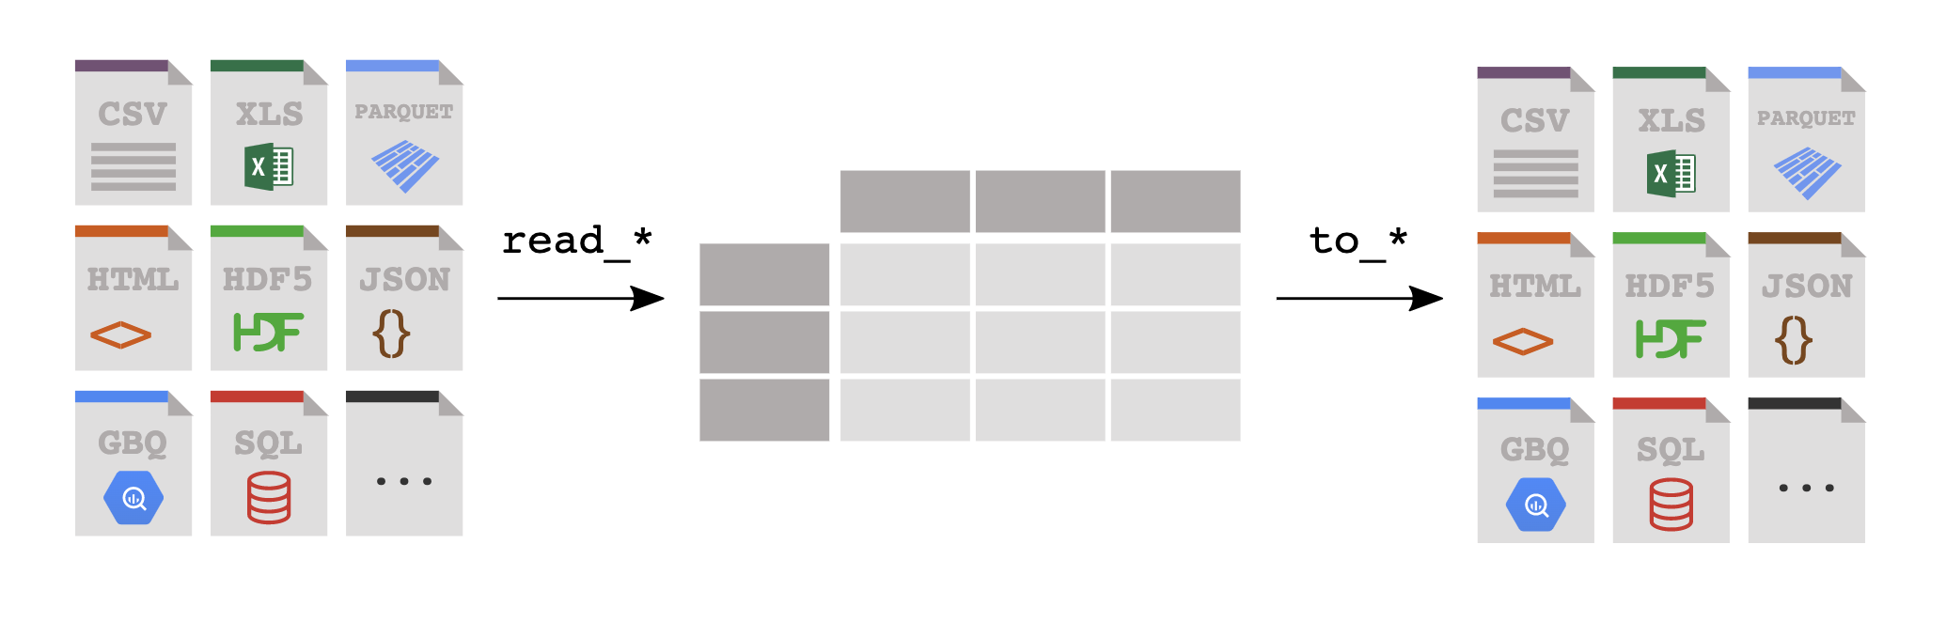
Introduction to Pandas
There exists a library that, despite its cute and cuddly name, is extraordinarily powerful when it comes to visualizing, analyzing, and altering large datasets. This library is Pandas.
Pandas

Slide 7
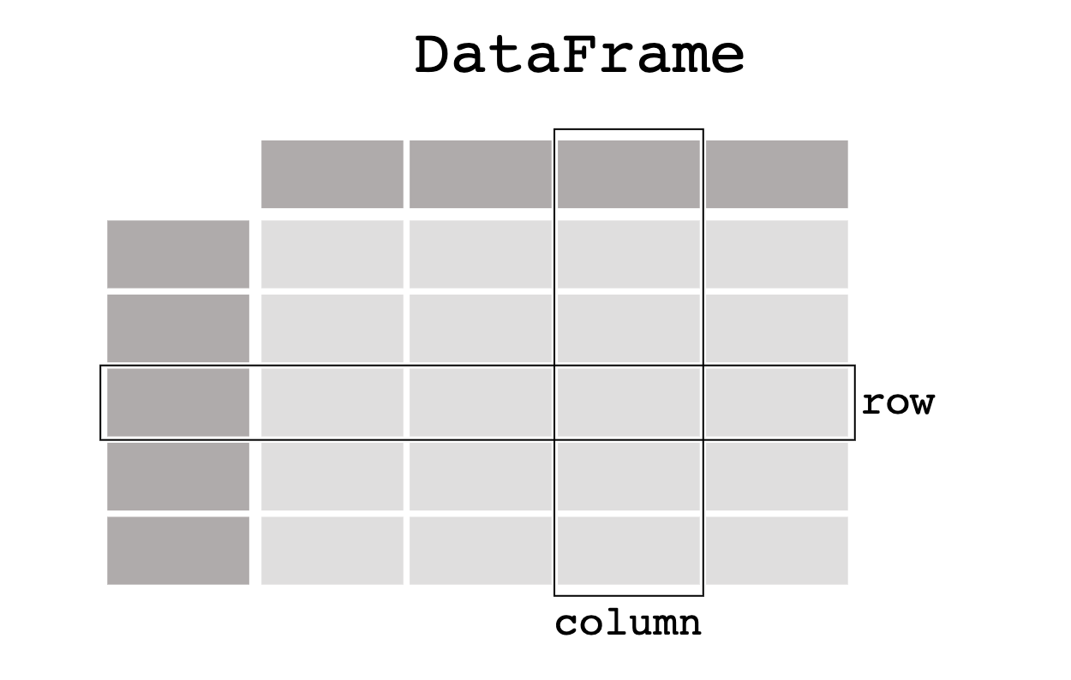

Introduction to Pandas
While Python alone is stuck using lists, tuples, and dictionaries, Pandas lets Python programmers work with "Series" and "DataFrames"
Each Column in a DataFrame is a Series.

Slide 8
DataFrame Creation
Few thing to note when creating a DataFrame
First, import Pandas library running import pandas as pd.This method of import allows Pandas functions/methods to be called using the variable pd.
To create a Series, simply run pd.Series() function and place a list within the parentheses. Note that the index for the values within the Series will be the numeric index of the initial list.

Slide 9
DataFrame Creation
Few thing to note when creating a DataFrame
One of many different ways to create DataFrames from scratch is to use the pd.DataFrame() function and provide it with a list of dictionaries. Each dictionary will represent a new row where the keys become column headers and the values will be placed inside the table.
Another way to use pd.DataFrame() function is to provide a dictionary of lists. The keys of the dictionary will be the column headers and the listed values will be placed into their respective rows. THIS WILL BE THE MOST COMMON WAY YOU WILL SEE US CREATE DATAFRAMES.

Slide 10
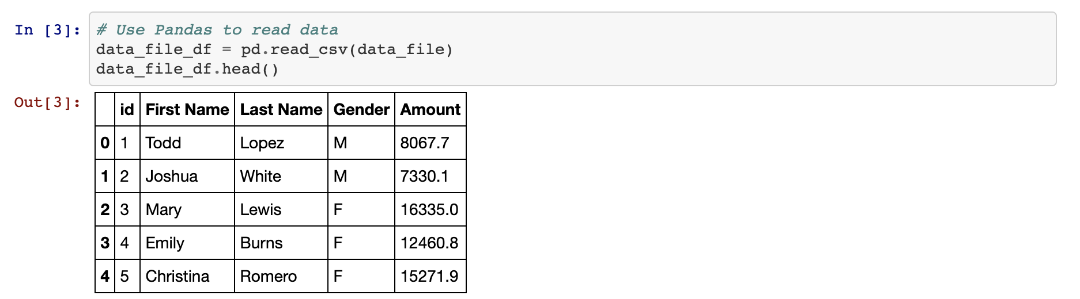
DataFrame Functions
Built in Function: head()
The head() method is helpful insomuch as it allows the programmer to look at a minified version of a much larger table, thus allowing them to make informed changes without having to search through the entire dataset.

Slide 11
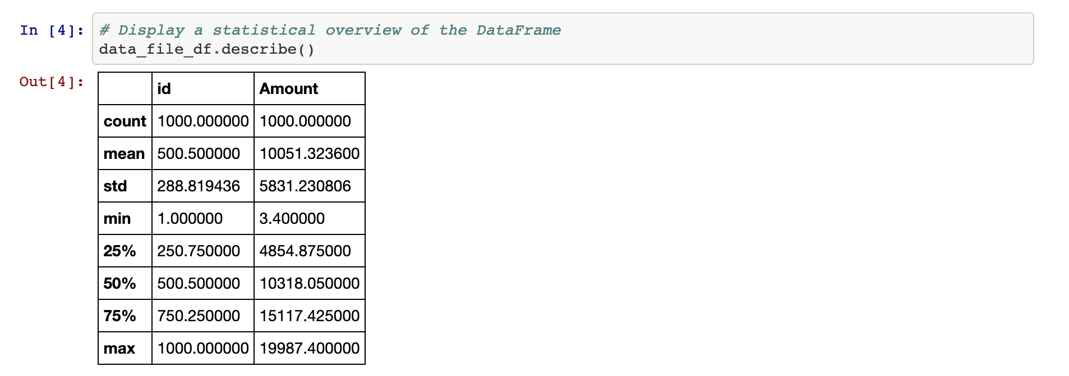
DataFrame Functions
Built in Function: describe()
The describe() method will print out a DataFrame containing some analytic information on the table and its columns. It is also helpful in showing what other data functions can be performed on a DataFrame or Series.

Slide 12
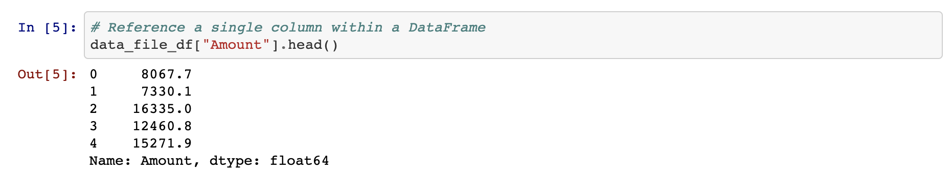
DataFrame Functions
Working with a single column
Most data functions can also be performed on a Series by referencing a single column within the whole DataFrame.
This is done in a similar way to referencing a key within dictionary by taking the DataFrame and following it up with brackets with the desired column's header contained within like a key.

Slide 13
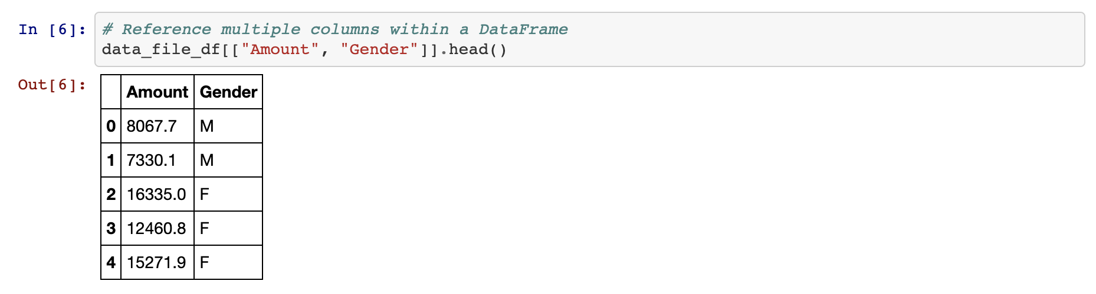
DataFrame Functions
Working with multiple columns
Multiple columns can be referenced as well by placing all of the column headers desired within a pair of double brackets. If two sets of brackets are not used then Pandas will return an error.

Slide 14
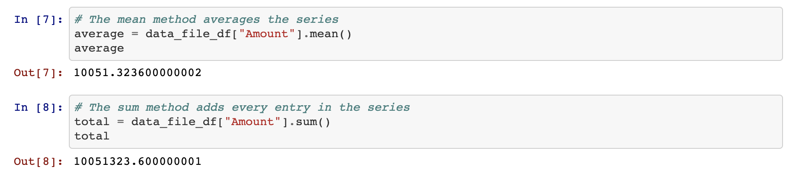
DataFrame Functions
Couple of Aggregating Functions
.mean() method simply computes the mean.
.sum() method add the values.

Slide 15
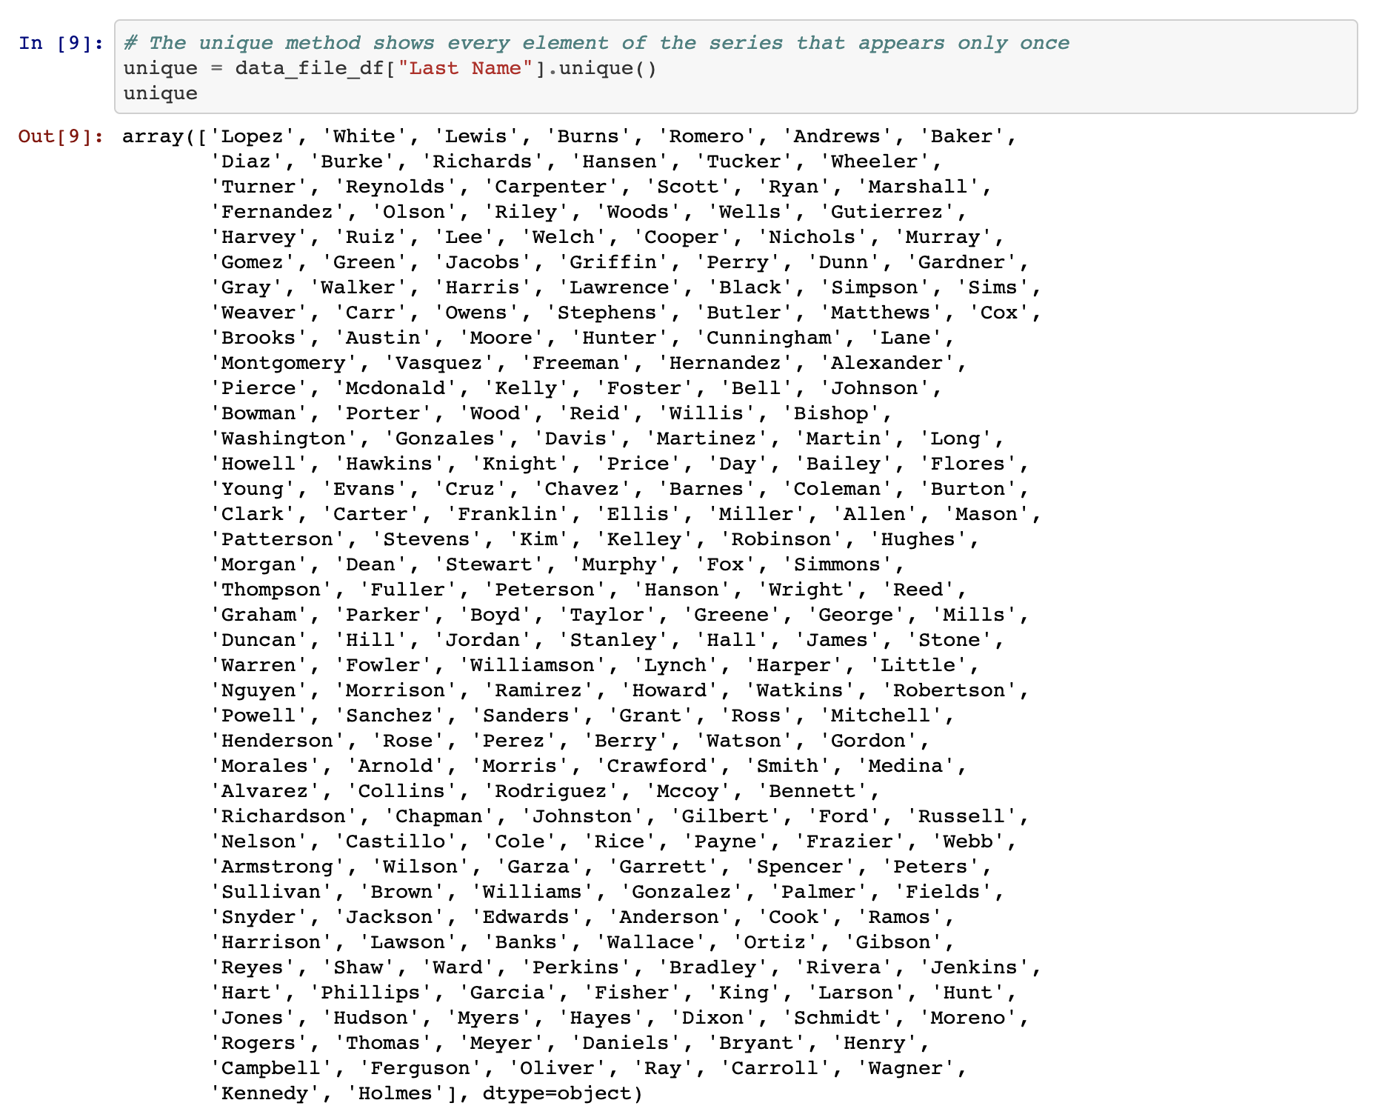
DataFrame Functions
Built in Function: unique()
There are situations in which it is helpful to list out all of the unique values stored within a column. This is precisely what the unique() function does by looking into a Series and returning all of the different values within.

Slide 16
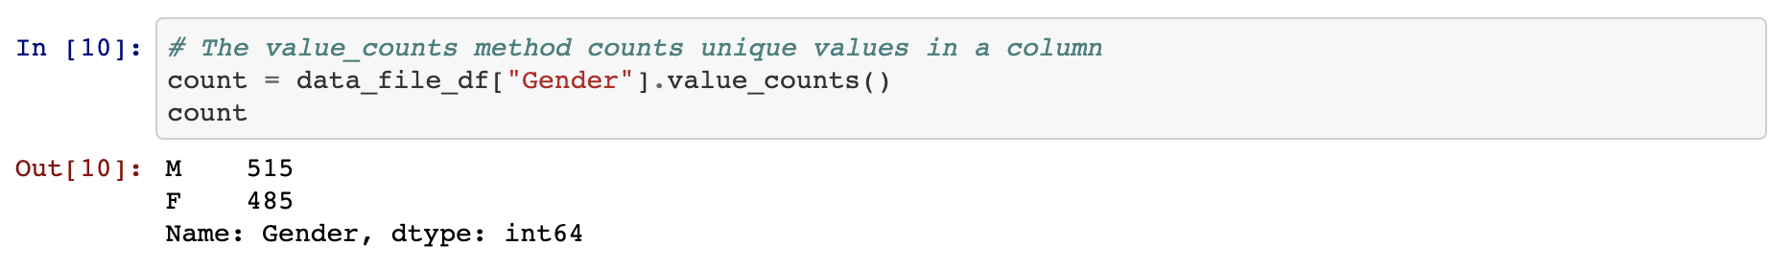
DataFrame Functions
Built in Function: value_counts()
Another method that holds similar functionality is that of value_counts() which not only returns a list of all unique values within a series but also counts how many times a value appears.

Slide 17
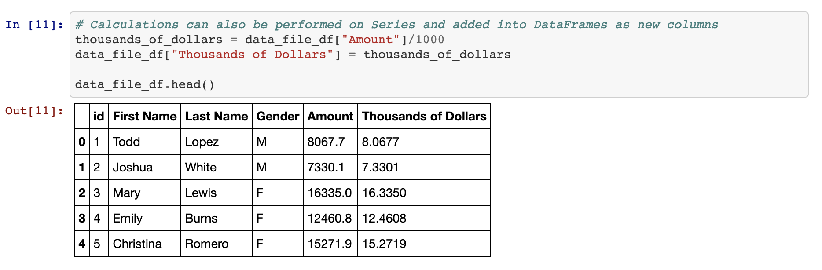
DataFrame Functions
Beyond Pandas Visualization Power...
Calculations can also be performed on columns and then added back into a DataFrame as a new column by referencing the DataFrame, placing the desired column header within brackets, and then setting it equal to a Series.

Slide 18
Modifying Columns
Columns Manipulation
There it is a very easy way to modify the names/placement of columns using the rename() function and the use of double brackets.
Use the df.columns method and it will call and an object containing the column headers will be printed to the screen.

Slide 19
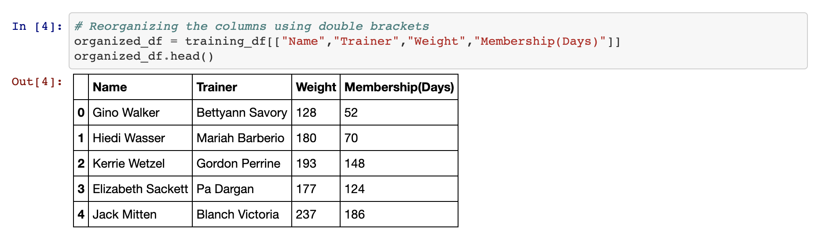
Modifying Columns
Columns Manipulation
To reorder the columns, create a reference to the DataFrame followed by two brackets with the column headers placed in the order desired.
It is also possible to remove columns in this way by simply not creating a reference to them. This will, in essence, drop them from the newly made DataFrame.

Slide 20
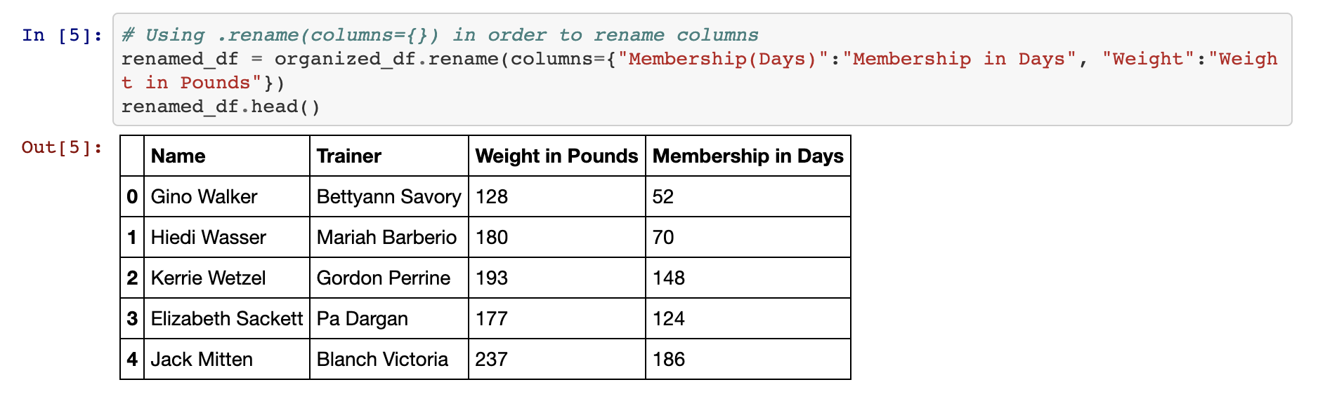
Modifying Columns
Columns Manipulation
To rename the columns within a DataFrame, use the df.rename() method and place columns={} within the parentheses.
Inside of the dictionary, the keys should be references to the current columns and the values should be the desired column names.

Slide 21
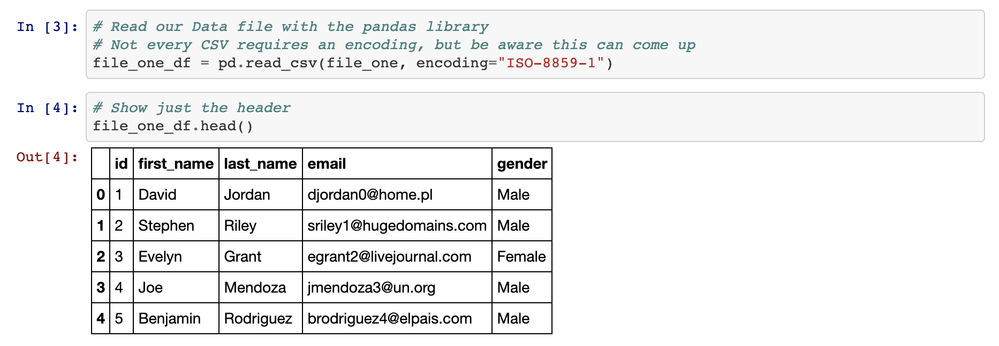
Reading and Writing CSV Files
A Far More Effective Way...
A CSV file's path can be created and passed into the pd.read_csv() method, making certain to store the returned DataFrame within a variable.

Slide 22
Reading and Writing CSV Files
A Far More Effective Way...
It is just as easy to write to a CSV file as it is to read from one. Simply use the df.to_csv() method, passing the path to the desired output file. By using the index and header parameters, programmers can also manipulate whether they would like the index or header for the table to be passed as well.

